Slide 1
II. Incremental and iterative Development Model

Slide 2
The incremental development model
an approach in which the project is divided into smaller, deliverable portions called increments.
Each increment is completed and delivered one at a time, gradually building up to the final product.
Each piece is fully functional, adding new capabilities or features to the previous work.
Example:
Imagine building an e-commerce website using the incremental model. The first increment could be the core shopping cart functionality. Later increments would add features like payment processing, user accounts, and product search, with each phase delivering a fully functional component.

Slide 3
Incremental development
Rather than deliver the system as a single delivery, the development and delivery is broken down into increments with each increment delivering part of the required functionality.
User requirements are prioritised and the highest priority requirements are included in early increments.
Once the development of an increment is started, the requirements are frozen though requirements for later increments can continue to evolve.

Slide 4
Characteristics of the Incremental Model
Completion of Work in Parts: Each increment is a self-contained part, with each new increment adding to the project’s functionality.
Early Customer Feedback: Stakeholders can provide input after each increment, which guides future development.
Quick Wins: By delivering functional parts early, incremental development allows for faster access to project benefits

Slide 5
Best Use Cases:
When delivering completed, functional parts early benefits customers.
Projects with well-defined requirements for each increment.
Ideal for traditional or hybrid project approaches that benefit from clear, segmented phases.

Slide 6

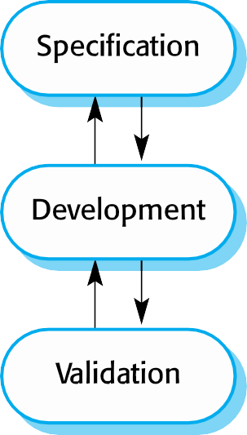
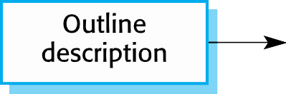

Incremental development

Slide 7
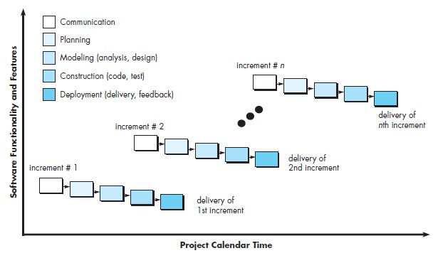

Slide 8
Incremental model
The model is used in the following scenarios:
A new technology is being used and learnt by the development team while working on the project
Resources with needed skill set are not available and planned to be used on contract basis for specific iterations
There are some high risk features and goals which may change in the future

Slide 9



Incremental development benefits
The cost of accommodating changing customer requirements is reduced.
It is easier to get customer feedback on the development work that has been done.
Customers can comment on demonstrations of the software and see how much has been implemented.
More rapid delivery and deployment of useful software to the customer is possible.
Customers are able to use and gain value from the software earlier than is possible with a waterfall process.
The amount of analysis and documentation that has to be redone is much less than is required with the waterfall model.

Slide 10


Incremental development problems
The process is not visible.
System structure tends to degrade as new increments are added.
Unless time and money is spent on refactoring to improve the software, regular change tends to corrupt its structure. Incorporating further software changes becomes increasingly difficult and costly.
Managers need regular deliverables to measure progress. If systems are developed quickly, it is not cost-effective to produce documents that reflect every version of the system.

Slide 11
When to use Incremental Model
The requirements of the complete system are clearly defined and understood.
Major requirements must be defined; however, some details can evolve with time.
There is a need to get a product to the market early.
A new technology is being used
Resources with needed skill set are not available
There are some high risk features and goals

Slide 12
Integration and configuration
Based on systematic reuse where systems are integrated from existing components or COTS (Commercial-off-the-shelf) systems.
Process stages
Component analysis;
Requirements modification;
System design with reuse;
Development and integration.
Reuse is now the standard approach for building many types of business systems.
The move to reuse-based development has been in response to demands for lower software production and maintenance costs, faster delivery of systems, and increased software quality

Slide 13
Iterative Development Model
Focuses on refining the product through repeated cycles (iterations). Rather than completing one feature at a time, each cycle improves or modifies an earlier version of the product until the final requirements are met.
This approach is especially useful when requirements are unclear or may change over time.
Example
Developing a new software feature iteratively might start with a basic prototype, which is refined over multiple cycles, enhancing functionality, performance, and user experience until it meets final requirements.

Slide 14
Characteristics of the Iterative Model
Continuous Refinement: Each iteration builds on previous work, improving or enhancing functionality.
Learning and Adjustment: Stakeholder feedback is incorporated into each cycle, making it suitable for projects where requirements may evolve.
Evolving Product: Early iterations may not be fully functional but gradually become refined until the product meets all specifications

Slide 15
Best Use Cases:
When project requirements are unclear or likely to evolve.
Projects where feedback and refinement improve the final outcome.
Suitable for agile and adaptive project management methods where continuous improvement is prioritized.

Slide 16
Benefits of Each Model
Incremental Model
Iterative Model
Delivers functional parts earlier, providing immediate value.
Allows for phased delivery and progress visibility.
Reduces project risk by delivering smaller, complete sections of the product.
Allows for continuous refinement and supports evolving requirements.
Encourages frequent stakeholder feedback, leading to a product that aligns closely with user needs.
Enables flexibility, adapting the product as the project advances.

Slide 17
Drawbacks of Each Model
Iterative Model
Incremental Model
Requires well-defined requirements upfront.
May restrict flexibility if incremental planning is rigid.
Limited scope for adjustment once an increment is planned
May not deliver functional components early since early iterations are often prototypes.
Can lead to scope creep if refinements aren’t well managed.
Requires careful management to avoid excessive iteration without progress toward the final product.
Whatch on youtube

Slide 18
Combining Incremental and Iterative Approaches
In practice, many projects use a blend of incremental and iterative approaches, especially within agile frameworks.
This hybrid approach, known as incremental-iterative development, delivers a functional part of the product as an increment while continuously refining it through iterations.
This combination is often seen in agile methods like Scrum, where each sprint represents both an increment (delivering a potentially shippable product) and an iteration (where improvements and feedback adjustments occur).

Slide 19
Example: In an incremental-iterative approach, a project could deliver an increment with a minimum viable product (MVP) that undergoes multiple iterations to enhance usability, performance, and additional features based on user feedback.

Slide 20
Summary (Incremental and iterative Development Model)

Slide 21
Incremental Development
Focus: Building the product in separate, deliverable parts that are fully functional.
Process: The project is broken down into smaller, self-contained pieces, and each piece is built and delivered sequentially.
Outcome: The final product is a sum of these completed parts, which are added to the already existing functionality.
Example: Delivering a software application by first releasing the core login feature, then adding a search functionality, followed by a payment system.

Slide 22
Iterative Development
Focus: Refining the product through repeated cycles of design, development, and testing.
Process: The product is developed in cycles, with each cycle building on the previous one, allowing for continuous improvement based on feedback.
Outcome: The product is continuously enhanced and improved with each iteration, getting closer to the final, desired product.
Example: An initial version of a feature is released, and then subsequent iterations focus on refining that feature's design, functionality, and performance based on user feedback.

Slide 23
Key Differences
Building vs. Refining: Incremental development is about building new features, while iterative development is about refining what's already built.
Functionality: Incremental development delivers fully working, distinct functional parts, whereas iterative development improves the existing functionality within each cycle.
Product Evolution: With incremental development, the product grows by adding new features. With iterative development, the product evolves by improving and adapting existing features.

Slide 24
Incremental development builds a product in pieces or "increments," delivering functional parts sequentially.
Iterative development refines the product through multiple cycles of development, testing, and feedback to improve quality and functionality over time.
Increments add new features or functionality in stages, while iterations improve existing features through repeated cycles

Slide 25
How They Work Together
Agile development often uses both iterative and incremental approaches simultaneously.
This means that a project can be broken into small, deliverable increments (features) and that each of these increments can be refined through multiple iterations of development.

Slide 26
III. Agile Development
Agile Software Development - Principles, Patterns, and Practices; Robert C. Martin; 2003

Slide 27
Terms and keywords
Agile Software Development Life-Cycle (SDLC) Model
Agile SDLC model is a combination of iterative and incremental process models with focus on process adaptability and customer satisfaction by rapid delivery of working software product. An agile SDLC model defines a software process which follows the Agile Principles and applies an Agile Software Development Method.
Agile Manifesto (Agile Principles)
The Agile Manifesto is the foundation of most Agile Software Development methods. It has 4 core values supplemented by 12 Principles. The document was developed in 2001 by a group of 17 pioneer software engineers (www.agilemanifesto.org).
Agile Software Development Methods
Agile Software Development Methods (or Agile Methods) is a group of methodologies for developing software based on the guidelines of the Agile SDLC model and the principles of the Agile manifesto. Representative methods are: Extreme Programming, SCRUM, KANBAN, DSDM, FDD, Crystal Family of methods etc.

Slide 28
Traditional Software Development (SD)
Traditional software development life-cycle (SDLC) models (e.g., the Waterfall method or variations such as the V- Model) are rigid and heavyweight:
They follow a sequence of pre-determined stages (requirements definition, design, implementation, testing and deployment).
They require a stable and fully known set of requirements at the
very beginning of a project.
They require detailed documentation to guide all development activities.
Handling changes during the development lifecycle can be difficult.
In traditional SDLC models, the project success relies on knowing all software requirements before design and implementation begin.

Slide 29
Agile Software Development (SD)
Agile software development (SD) is a group of software development methods which adopt iterative and incremental development to encounter the limitations of traditional SD methods.
Agile SD methods utilize and further extend the idea/use of iterative/incremental development adopted by evolutionary prototyping, incremental development and Spiral.
Iterative/Incremental development starts with an initial planning and results in the final system deployment, though applying iterations in the between, each one delivering an evolutionary increment of a software artifact.

Slide 30
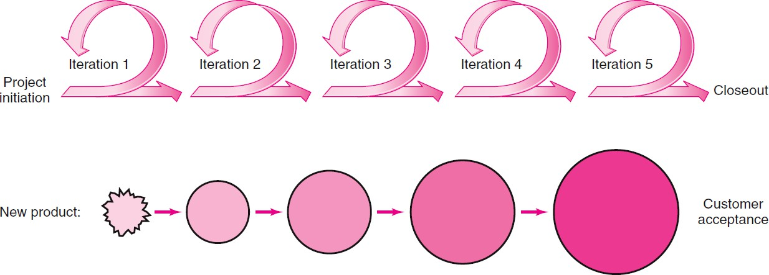
Phases in Agile SD (1/2)
Phases within an agile SD life-cycle are repeatedly executed and continuously revisited.
Development activities iteratively enhance the functionality of the software by considering customer feedback.
The development life-cycle is divided into small parts, called “increments” or “iterations”.

Slide 31
Phases in Agile SD (2/2)
Iterations are applied to each of the conventional tasks of traditional SD (requirements definition, design, programming, testing).
Each iteration incrementally evolves the software product by developing, almost on a daily basis, additional user requirements (also called user stories), implemented in the form of software functionalities, which are called software features.
A series of iterations develops a software release, i.e., a version of the system that can be successfully deployed.

Slide 32
Basic Concepts in Agile SD (1/2)
In Agile SD requirements and their implementation solutions (software components) evolve through collaboration between:
self-organizing and cross-functional teams
by exploiting continuous involvement of the users.
Agile SD adopts:
adaptive planning and evolutionary development/delivery
of software
to achieve end-user/customer satisfaction.

Slide 33
Basic Concepts in Agile SD (2/2)
Agile SD follows a “time-boxed” iterative approach to provide rapid and flexible/adaptive response to changes.
Agile SD methods are ‘lightweight’ and ‘human-centric’ with the aim to create business value.
Agile SD can be regarded as a conceptual framework that promotes foreseen interactions among stakeholders throughout the SD life-cycle.
Agile SD life-cycle model is a software process which follows the agile principles and applies an Agile SD method.

Slide 34
Representative Agile SD Methods
SCRUM
Extreme Programming (XP)
KANBAN
Crystal methods
Dynamic Software Development Method (DSDM)
Feature-Driven Development (ADD)
etc.

Slide 35
Characteristics of Agile methods
Emphasis on code rather than design.
Follow an iterative approach to SD.
Target to deliver working software quickly.
Evolve quickly to meet changing requirements.
Assume active customer involvement.
People-based rather than Plan-based development.

Slide 36
The Agile Manifesto
We are uncovering better ways of developing software by doing it and helping others do it. Through this work we have come to value:
Individuals and interactions over processes and tools
Working software over comprehensive documentation
Customer collaboration over contract negotiation
Responding to change over following a plan
That is, while there is value in the items on the right, we value the
items on the left more.
Source: The Agile Manifesto (2001). Manifesto for agile software development. https://agilemanifesto.org/

Slide 37
Twelve Agile Principles based on the Agile Manifesto (1/3)
Our highest priority is to satisfy the customer through early and
continuous delivery of valuable software.
Welcome changing requirements, even late in development. Agile processes harness change for the customer's competitive advantage.
Deliver working software frequently, from a couple of weeks to a couple of months, with a preference to the shorter timescale.
Business people and developers must work together daily throughout the project.
Source: The Agile Manifesto (2001). Principles behind the Agile Manifesto. https://agilemanifesto.org/principles.html

Slide 38
Twelve Agile Principles based on the Agile Manifesto (2/3)
Build projects around motivated individuals.
Give them the environment and support they need, and trust them to get the job done.
The most efficient and effective method of
conveying information to and within a development team is face-to- face conversation.
Working software is the primary measure of progress.
Agile processes promote sustainable development. The sponsors, developers, and users should be able to maintain a constant pace indefinitely.
Source: The Agile Manifesto (2001). Principles behind the Agile Manifesto. https://agilemanifesto.org/principles.html

Slide 39
Twelve Agile Principles based on the Agile Manifesto (3/3)
Continuous attention to technical excellence and good design enhances agility.
Simplicity-the art of maximizing the amount of work not done-is essential.
The best architectures, requirements, and designs emerge from self-organizing teams.
At regular intervals, the team reflects on how
to become more effective, then tunes and adjusts its behavior accordingly.
Source: The Agile Manifesto (2001). Principles behind the Agile Manifesto. https://agilemanifesto.org/principles.html

Slide 40
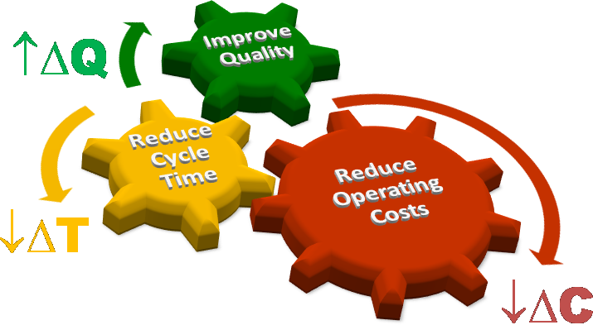
Advantages of using the Agile Methods
Adaptability to changing market/customer needs
Better cost efficiencies and fastest time-to-market
Improved quality, customer/developer satisfaction, and project success

Slide 41
Limitations of Agile Methods
May do not satisfy top management’s needs for tight budget, scope, and schedule control.
Self-organization and intensive collaboration can be incompatible with the culture of some corporates.
Agile methods appear to be effective for small/medium- scale projects that require only five-nine dedicated team members to complete the work.
Active customer involvement/cooperation is not always possible.

Slide 42
Characteristics of Agile Software Development

Slide 43







Agile Characteristics based on the Agile Principles
Adaptive planning
Evolutionary development with focus on customer value/satisfaction
Continuous user involvement
Self - organized / Cross - functional teams
Lightweight Process
Human-centric Approach

Slide 44
Adaptive Planning: High-level principles (1/2)
Planning at multiple levels: the amount of information considered at
each planning level (release, iteration and daily planning) results in
continuously delivering a high value product.
Two-way communication: Both team members and customers are involved in planning.
Transparency: Frequent deliveries and progress demonstration keep
all stakeholders updated and informed.
Handing uncertainty: the process is adapted to fit with different types
of project risks by minimizing uncertainties, risk and need for rework.
Consideration of the product backlog (i.e., the set of the candidate
software features to be delivered) makes iteration planning
adaptable and flexible: a specific person (e.g., the Product Owner in
terms of the SCRUM method) is responsible for maximizing the
product value resulting from the development work. The product
owner considers how changes influence the release plan. Depending
on the project needs and features’ priorities, the plan is updated continuously.

Slide 45
Adaptive Planning: High-level principles (2/2)
Estimating risks of a project is not limited to the project schedule and cost. Other risks are also considered (e.g., the team members velocity to implement the features, their availability, any distractions that may occur etc.)
Estimate ranges are used when assuming uncertainties.
Project work projection is based on the actual work progress rather than a predefined theoretical plan.
All possibilities about resource work are considered (e.g., ideal working time, unproductive time, team member absences etc.) to handle unexpected circumstances.

Slide 46
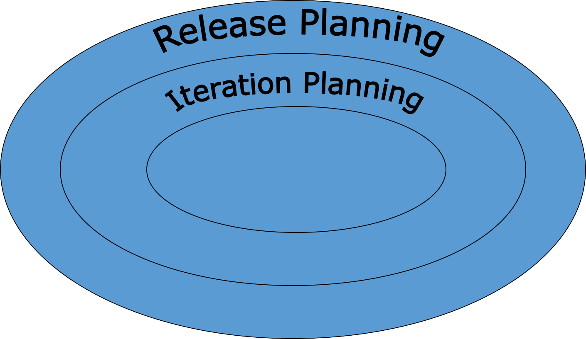
Adaptive Planning: Planning levels
Daily Planning
(stand-up meetings)

Slide 47
Adaptive Planning: Planning levels
Release Planning (on a monthly basis)
Planning goals: overall project scope, external communication
Planning the implementation of the features
Decided by the customers and the product owner
Iteration Planning (on 1-2 weeks basis)
Planning goals: scope of the next iteration, internal communication
Planning work tasks within an iteration
Driven by the development team members who prioritize software
features based on their value, cost of implementation, risk etc.
Daily Planning (daily standup meeting)
Primary goals: internal communication
Planning of individual work and coordination
Avoid unproductive time and duplicated effort
Not easy to “go dark” (difficult for a developer to try avoid working)

Slide 48
Adaptive Planning: Time-boxing
In agile SD the speed of delivering software to customers is critical and the
cost of delays is great.
Agile Manifesto principle:
“deliver working software frequently, ideally in a couple of weeks”
Time-boxing is a way to achieve this principle.
A time-box is the fixed time period during which development team members agree to complete a project activity.
Any iteration resulting in the delivery of an increment is time-boxed, by allocating a fixed
period of time to the iteration development activities.
Any undone work is moved to the next iteration or into subsequent iterations.
The ultimate objective is to establish a development rhythm for the software artifacts produced and delivered to customers.

Slide 49
Evolutionary SW Development (1/2)
“Adaptation to change” is a key value in the Agile Manifesto.
Evolutionary software development:
early, incremental and continuous delivery of working software.
The software is developed gradually with small portion at a time.
Adaptive and evolutionary refinement of plans, requirements, designs and software features, at each iteration.
Instead of defining and documenting all requirements upfront and refusing changes when implementing them, agile teams decide on requirements and features as late as possible.
Requirements are gathered and implemented iteratively.

Slide 50
Evolutionary SW Development (2/2)
For every iteration software components are presented to customers for review.
These components are not integrated as a full system: and rework or additional features would not marginally increase the project cost.
Developers are able to include features needed by the customers, and system integration will only occur when customers have no additional requirements.
The goal is to satisfy customers with a complete system containing all functions they desire

Slide 51
Continuous User Involvement
Agile methodologies emphasize in early and continuous communication/involvement with the customers.
In every iteration, the development team and the customers (or customer representatives) hold a meeting, where:
team members communicate and report their work done in the current iteration
customers provide feedback on the delivered software to refine current
features and propose additional features to be developed in the next
iteration.
Frequent software releases allow customers to:
acquire sufficient knowledge on the current release of the system
provide feedback to refine the requirements provided in the current
release
Frequent software releases allow development team members to:
be well-informed and competent to consider needed adjustments that
emerge during the development life-cycle

Slide 52
Self-organizing teams
Agile teams are self-organizing and self-managing.
Agile team members are accountable:
to deliver results that meet customer needs.
to each other and to other external teams for delivering quality work on time.
to keep a continuous flow of development in every iteration.

Slide 53
Cross-functional teams
Cross-functional teams are groups of people from different functional areas:
Groups are formed not only with technical specialists (e.g., designers, developers, quality assurance engineers/testers, etc.) but also consist of persons like business analysts, marketing specialists or other people taking an active part in the project.
A cross-functional team possesses all required domain knowledge and skills, without the need to rely on others outside of the team.

Slide 54
Lightweight process
Instead of “heavy” documentation, agile emphasizes on customer feedback and teams communication.
Change is embraced: iterate often, design and redesign, code and test frequently, keep the customer involved and informed.
Deliver software to the customer in short iterations (e.g., every 2 weeks).
Identify and eliminate defects early, thus reducing costs.

Slide 55

Human-centric approach (1/2)
Reliance on people and the interaction between them.
Development is not process-centric, but human-centric.
Frequent and effective personal communication and collaboration between the project stakeholders.
Intensive teamwork and high task interdependence.
Avoid ‘burnout’ of team members (allow a sustainable rhythm of work).

Slide 56
Human-centric approach (2/2)
Co-located teams, where possible.
Daily “stand-up” meetings, facilitated release planning workshops & retrospective meetings.
“Agile” physical design of the workspace and other communication tools:
Open-plan workspace and offices where everyone (including developers, testers, business experts, etc.) sits and interacts
Effective use of physical tools for communication and collaboration (e.g., visible white boards, task boards, status boards)
Use of post-it notes to denote the software features and their status of implementation.
Use of cards (e.g., user story cards) to specify the requirements.

Slide 57
Agile vs. Traditional Software Development

Slide 58
Agile vs Traditional (Plan-based) Software Development
Differences in Values
Agile Methods
‘Values’
Agile Methods
‘Principles’
Traditional Methods
‘Values’
Customer Collaboration
also known as
Early Customer Involvement
valued more than
Contract Negotiation
Working Software
also known as
Iterative Development
valued more than
Comprehensive Documentation
Individuals & Interactions
also known as
Self Organizing Teams
valued more than
Processes & Tools
Responding to Change
also known as
Adaptability or Flexibility
valued more than
Following a Plan
Source: The Agile Manifesto (2001). Manifesto for agile software development.
http://www.agilemanifesto.org
37

Slide 59

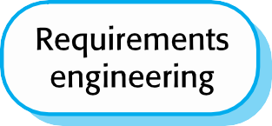
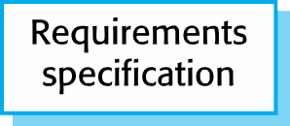
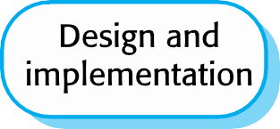



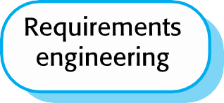

Agile vs Traditional (Plan-based) Software Development
Differences in Process Flow

Slide 60
Comparison between Agile and Traditional Software Development (1/2)
Traditional methods:
Concentrate on thorough, upfront planning of the entire project. Fixed project scope.
Require ‘up-front’ requirement gathering.
Design ‘up-front’.
Freeze requirements and design as early as possible.
Sequential execution. The development teams build the system in “one-shot” fashion.
Agile methods:
Rely on incremental, iterative development cycles. Flexible project scope.
Avoid ‘up-front’ requirement gathering. Agile has the ability to successfully deliver results quickly and inexpensively on complex projects with ill-defined requirements.
Continuous design.
Freeze requirements and design as late as possible.
Iterative/incremental and evolutionary/adaptable execution.

Slide 61
Comparison between Agile and Traditional Software Development (2/2)
Traditional methods:
Require a high degree of predictability to be effective. Good for projects with low uncertainty.
The cost of change is high.
Emphasis on contracts, plans, processes, documents, and tools.
Conventional project teams dedicated to specific tasks. Team members having specific technical expertise.
Low and late customer involvement.
Coherence to plan is the key priority.
Agile methods:
Ideal for less-predictable and exploratory projects in which requirements need to be discovered and new technology to be tested. Good for projects with high uncertainty.
The cost of change is low.
Emphasis on teams, working software, customer collaboration, and responding to change. Focus on active collaboration between the project team and customer representatives.
Self-organized and cross-functional project teams. Team members having both technical and soft skills.
High, early and continuous customer involvement.
Customer satisfaction and business return on investment (ROI) are the key priorities.

Slide 62
Summary of differences (1/3)
 | Traditional development | Agile development
Underlying principle | Software systems are specifiable and predictable. They can be developed through following detailed planning. | Software systems are adaptive to changes. High quality software is developed by small teams that use the iterative/continuous improvement based on customer feedback and changes.
Management style | Dictated by command and control. | Dictated by leadership and collaboration.
Communication model | Formal based on documents. | Informal based on productive collaboration.
Development model | Sequential. | Iterative/incremental/evolutionary.
Organizational structure | Bureaucratic, highly formalized, suited for large organizations. | Flexible, participative, encourages social cooperation, suited for small and medium organizations.

Slide 63
Summary of differences (2/3)
 | Traditional development | Agile development
Testing and quality control activities | Sequential execution of validation/verification activities. Testing is performed late, after the code is completed. | Continuous testing the requirements, design and the implementation artifacts. Testing is performed in every iteration
Definition of user requirements | Requirements are defined in detail and specified formally before the design/implementation begins. | Requirements are defined rather informally and they are continuously gathered/evaluated in every iteration.
Cost of restarting the project activities | High. | Low.
Development style | Fixed. | Flexible.
Customer involvement | Low. | High.

Slide 64
Summary of differences (3/3)
 | Traditional development | Agile development
Additional skills required from Developers | Technical skills are mainly required. | Technical skills and interpersonal/soft skills (e.g., communication skills) and knowledge of the business objectives.
Scale of projects | Medium scale projects. | Low and medium scale projects.
Requirements nature | Very stable, known in advance. | Unstable, emergent during the process
Architecture | Design represents all the specified requirements. | Design represents the requirements implemented in the current iteration.
Cost of redesign | Expensive. | Not expensive.
Size of the project team | Medium-large project teams. | Small-medium teams.
Primary objective | Adherence to the project plan. | Adherence to customer value.

Slide 65
Summary (Agile model)

Slide 66
Agile Model
Agile model believes that every project needs to be handled differently and the existing methods need to be tailored to best suit the project requirements.
In agile the tasks are divided to time boxes (small time frames) to deliver specific features for a release.
Iterative approach is taken and working software build is delivered after each iteration. Each build is incremental in terms of features; the final build holds all the features required by the customer.

Slide 67

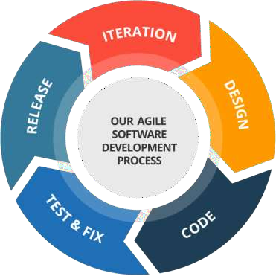
Agile Model

Slide 68
Agile Development - Key Points
The goal is to develop software quickly, in the face of rapidly changing requirements
Originally conceived for small to mid-sized teams
To achieve agility we need to ...
employ practices that provide the necessary discipline and feedback
employ design principles that keep “our” software flexible and maintainable
know the design patterns that have shown to balance those principles for specific problems

Slide 69
Agile Model: Strengths
Is a very realistic approach to software development.
Promotes teamwork and cross training.
Functionality can be developed rapidly and demonstrated.
Resource requirements are minimum.
Suitable for fixed or changing requirements.
Delivers early partial working solutions.
Little or no planning required.
Easy to manage.

Slide 70
Agile Model: Weaknesses
For larger projects, it is difficult to judge the efforts and the time required for the project in the SDLC.
Since the requirements are ever changing, there is hardly any emphasis, which is laid on designing and documentation. Therefore, chances of the project going off the track easily are much more.
Depends heavily on customer interaction, so if customer is not clear, team can be driven in the wrong direction.

Slide 71
Using an agile method does not mean that the stakeholders will always get what they want.
It simply means that they’ll be able to control the team to get the most business value for the least cost.

Slide 72
Some Agile Methods
Rapid Application Development (RAD)
Scrum
Extreme Programming (XP)
Adaptive Software Development (ASD)
Feature Driven Development (FDD)
Crystal Clear
Dynamic Software Development Method (DSDM)
Rational Unify Process (RUP)

Slide 73
END
34

